Slide 1
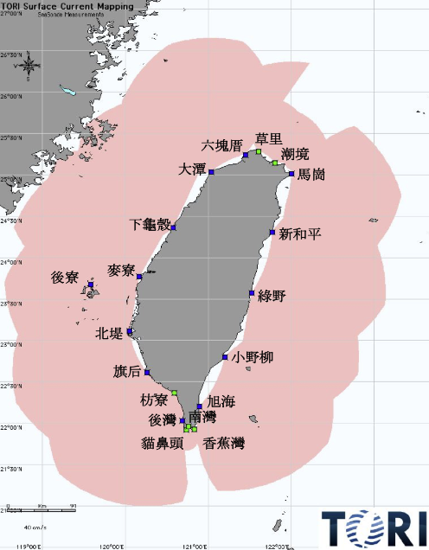
Analyses of surface currents around Taiwan derived from the TORI HF-Radar Observations

Slide 2
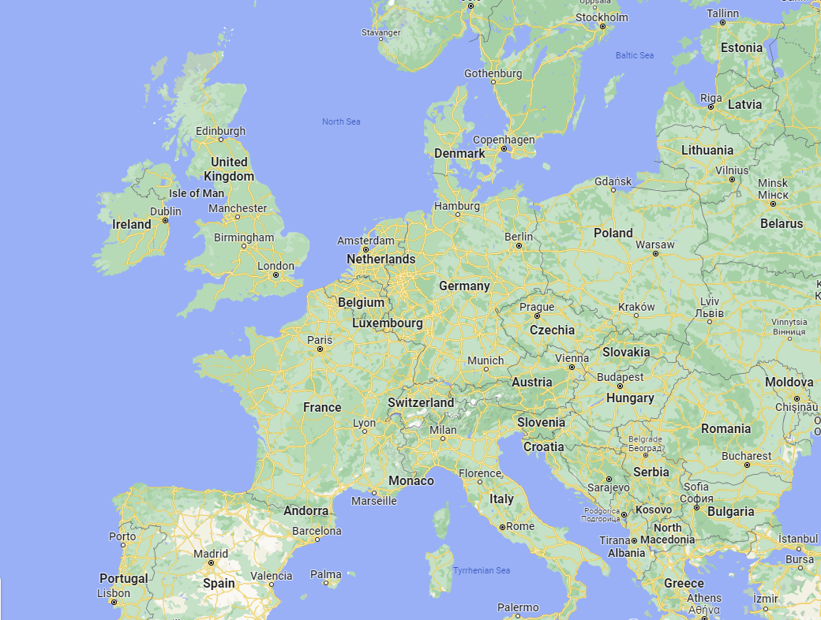
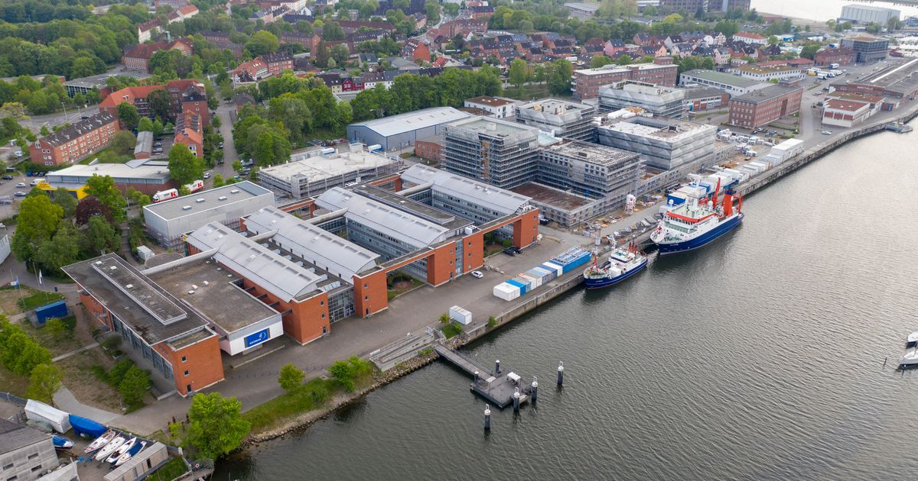
Who am I?
From Kiel, Germany
Master Student in Climate Physics
Studying at GEOMAR
Two months internship at TORI
Interested in physical oceanography
Observations
Modelling

Slide 3
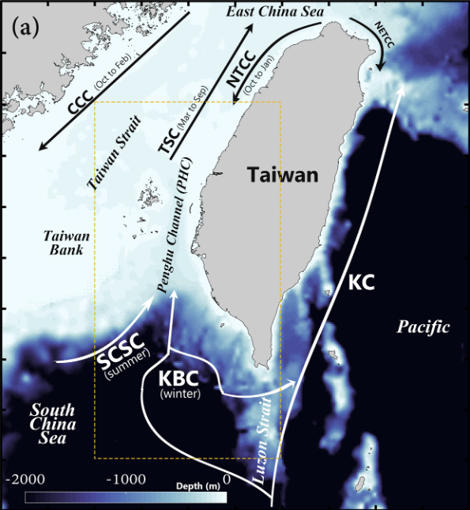
Motivation
Dynamically very interesting region
Kuroshio Current
Shallow Taiwan Strait
Does HF-Radar Data show these patterns?
How does the flow vary?
What is the relation to wind and large scale geostrophic dynamics?
Hsu2022

Slide 4
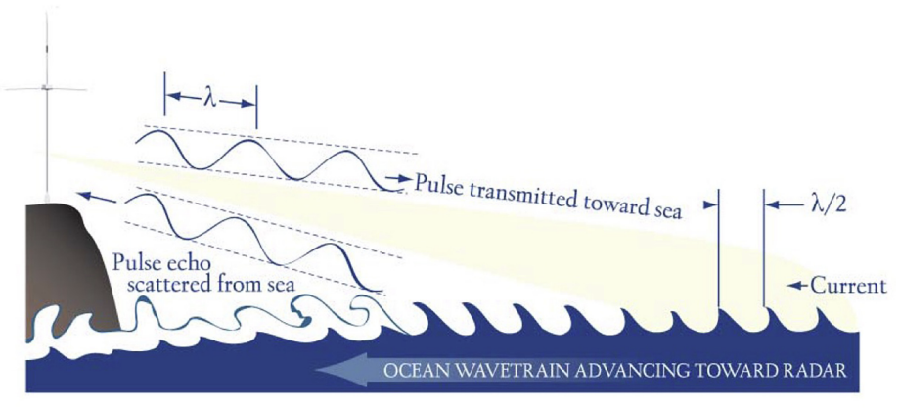
High-Frequency Radars
Antenna sends out pulse
Pulse gets reflected with a Doppler Shift
Measure reflected signal
Derive ocean velocity from that
Two antennas needed for 2D velocity
Roarty2019

Slide 5
Data
Period 2013/1/1 - 2017/12/31
CODAR
hourly
10km resolution
Winds
ERA5 Reanalysis
hourly
1/4º resolution
Geostrophic Flow
Satellite Altimetry
daily
1/4º resolution

Slide 6
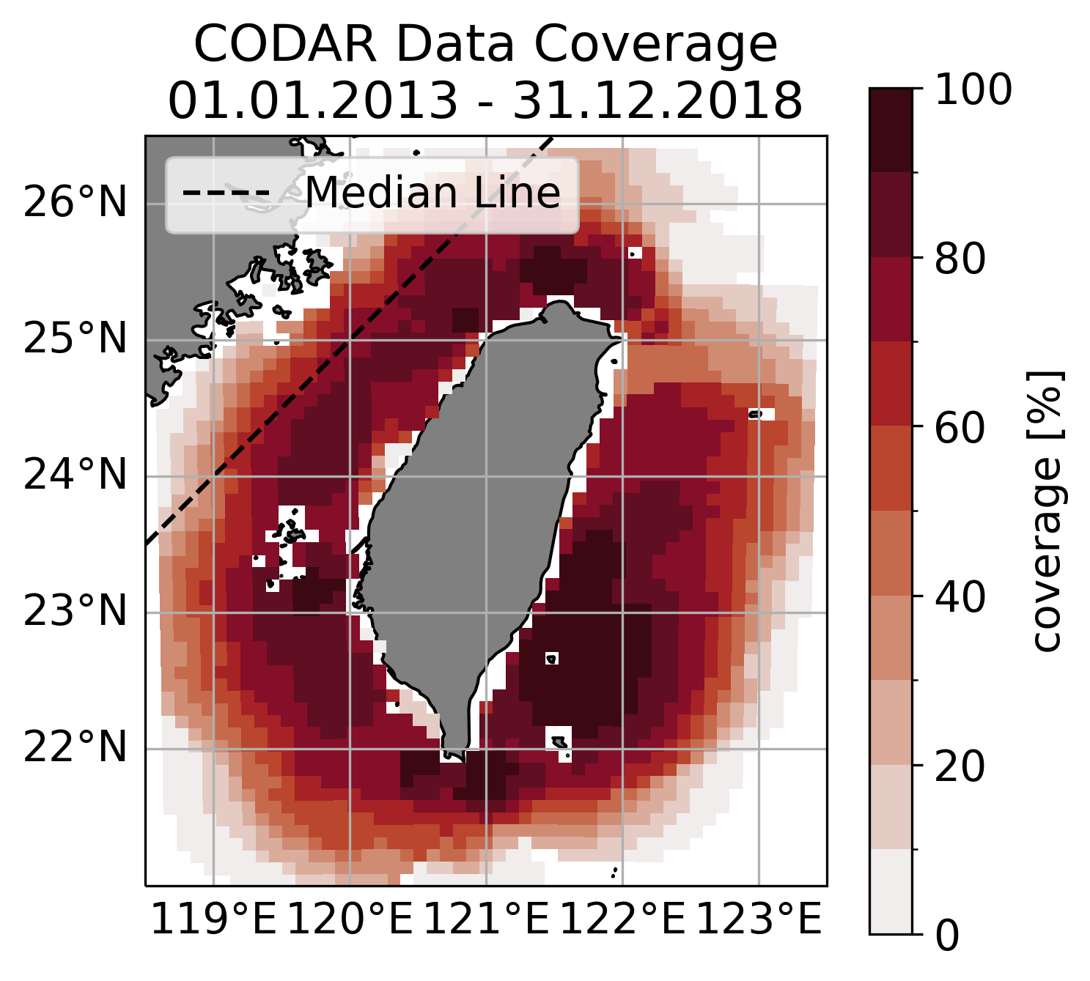
Data Coverage
Pretty good coverage around the island
What percentage is enough to trust results?
Trade-off between trustworthy results and enough points to see something

Slide 7
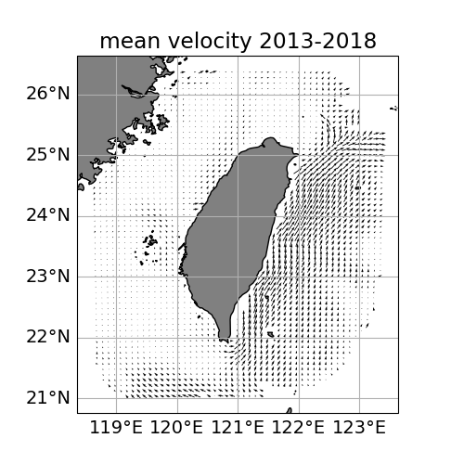
Mean Flow
Kuroshio Current
Weaker but probably more variable flow in Taiwan Strait
Pengu Channel and Coastal Current

Slide 8
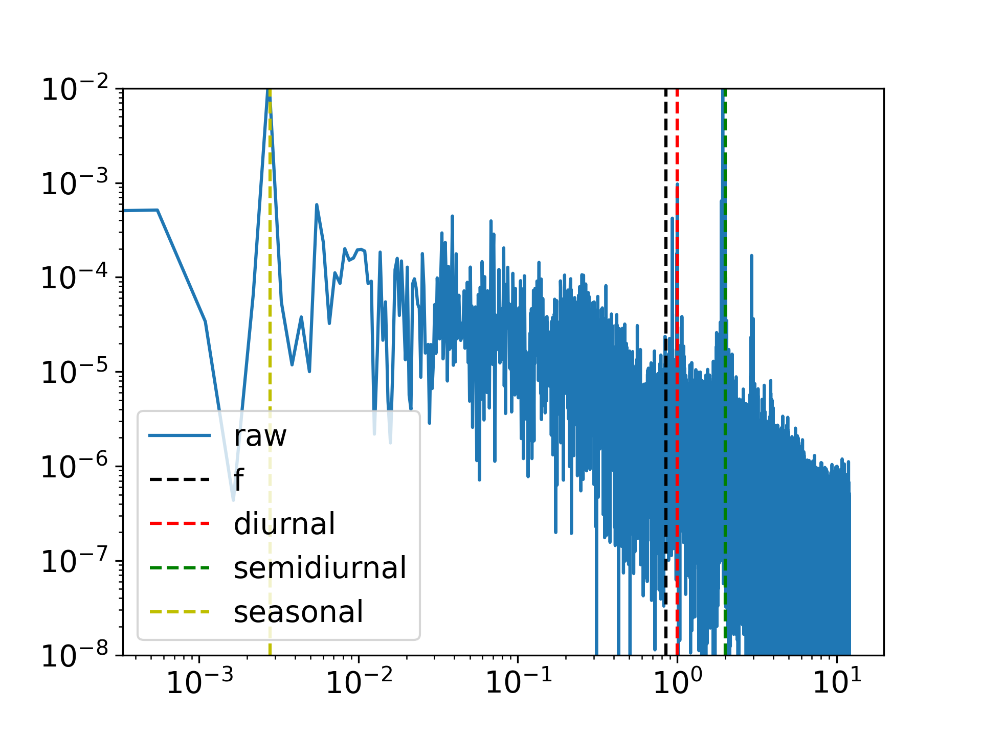
Spectral Analysis
Gaps in the data make it difficult
Non-uniform fast fourier transform
Clear peaks at seasonal and tidal frequencies

Slide 9
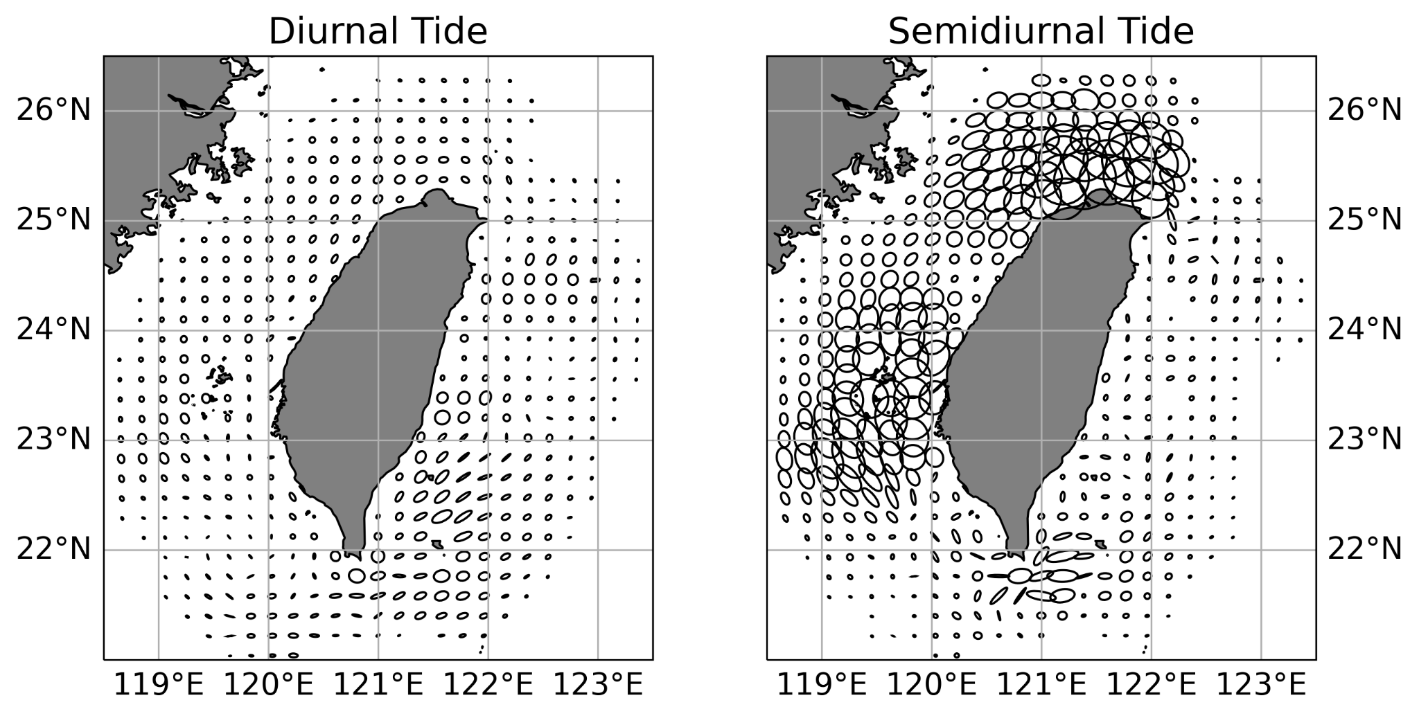
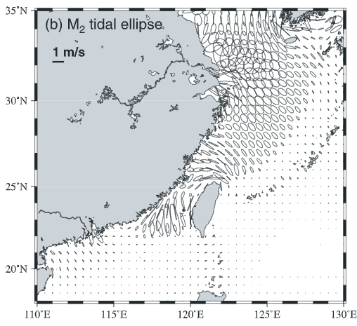
Tidal Ellipses
Jan2004
Semidiurnal tides stronger in Taiwan Strait
Diurnal in the eastern part
Fits to modelling study from Jan et al. 2004

Slide 10
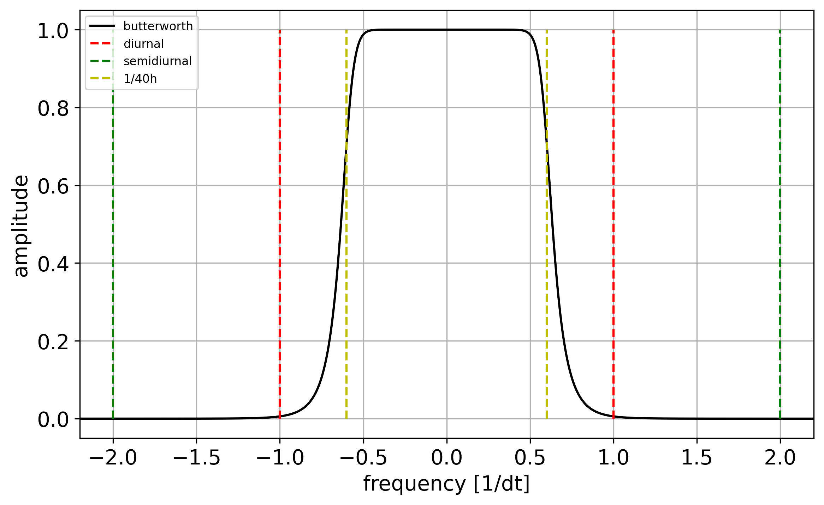
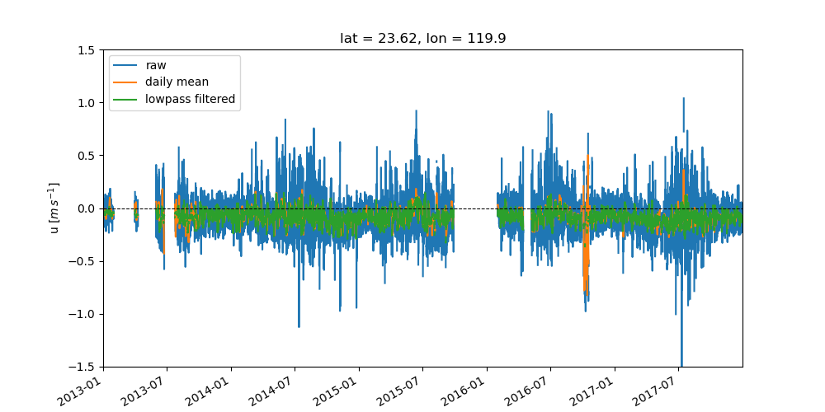
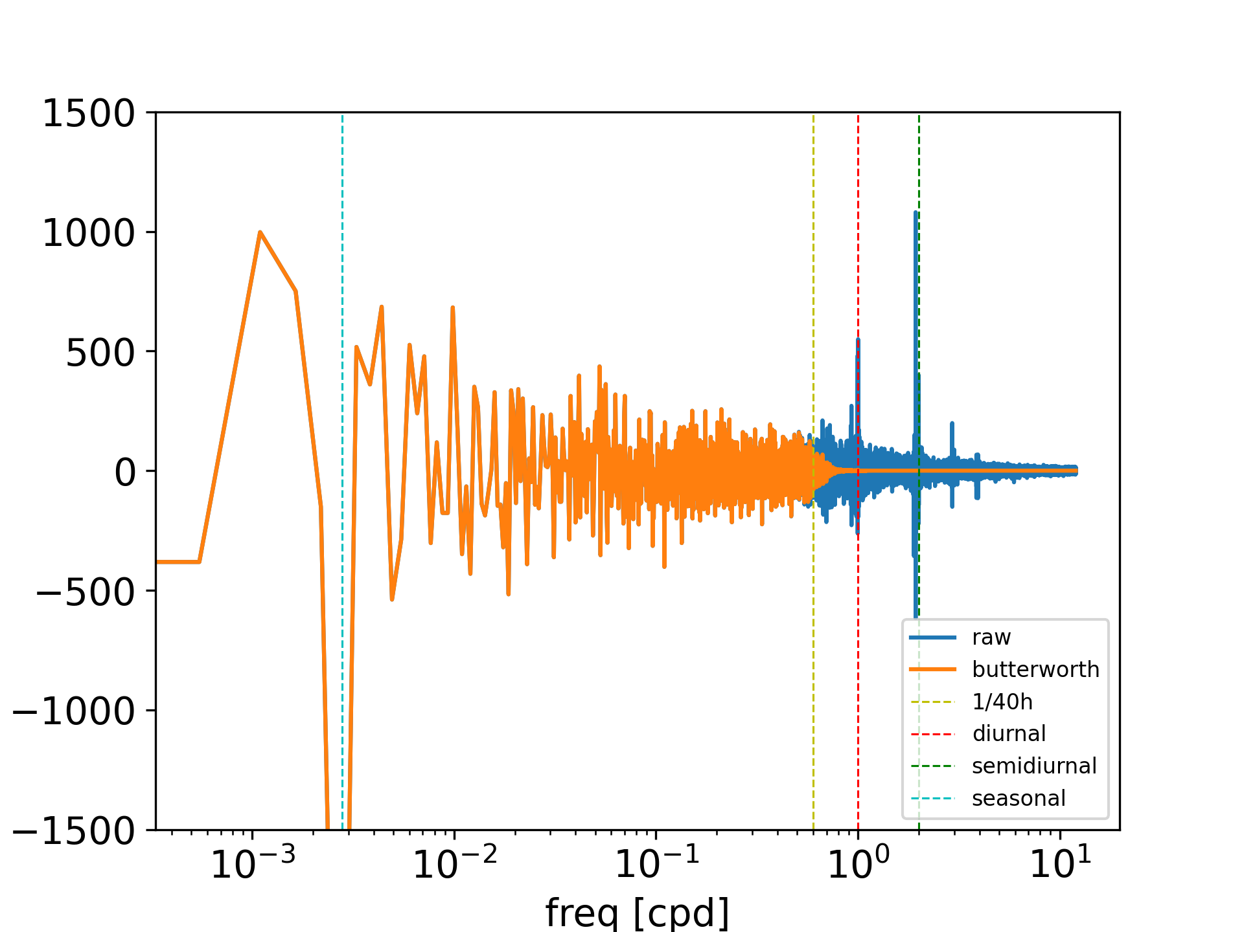
Time Filtering
Apply window function on frequency spectrum
Used butterworth window
Inverse non-uniform FFT to reconstruct time series

Slide 11
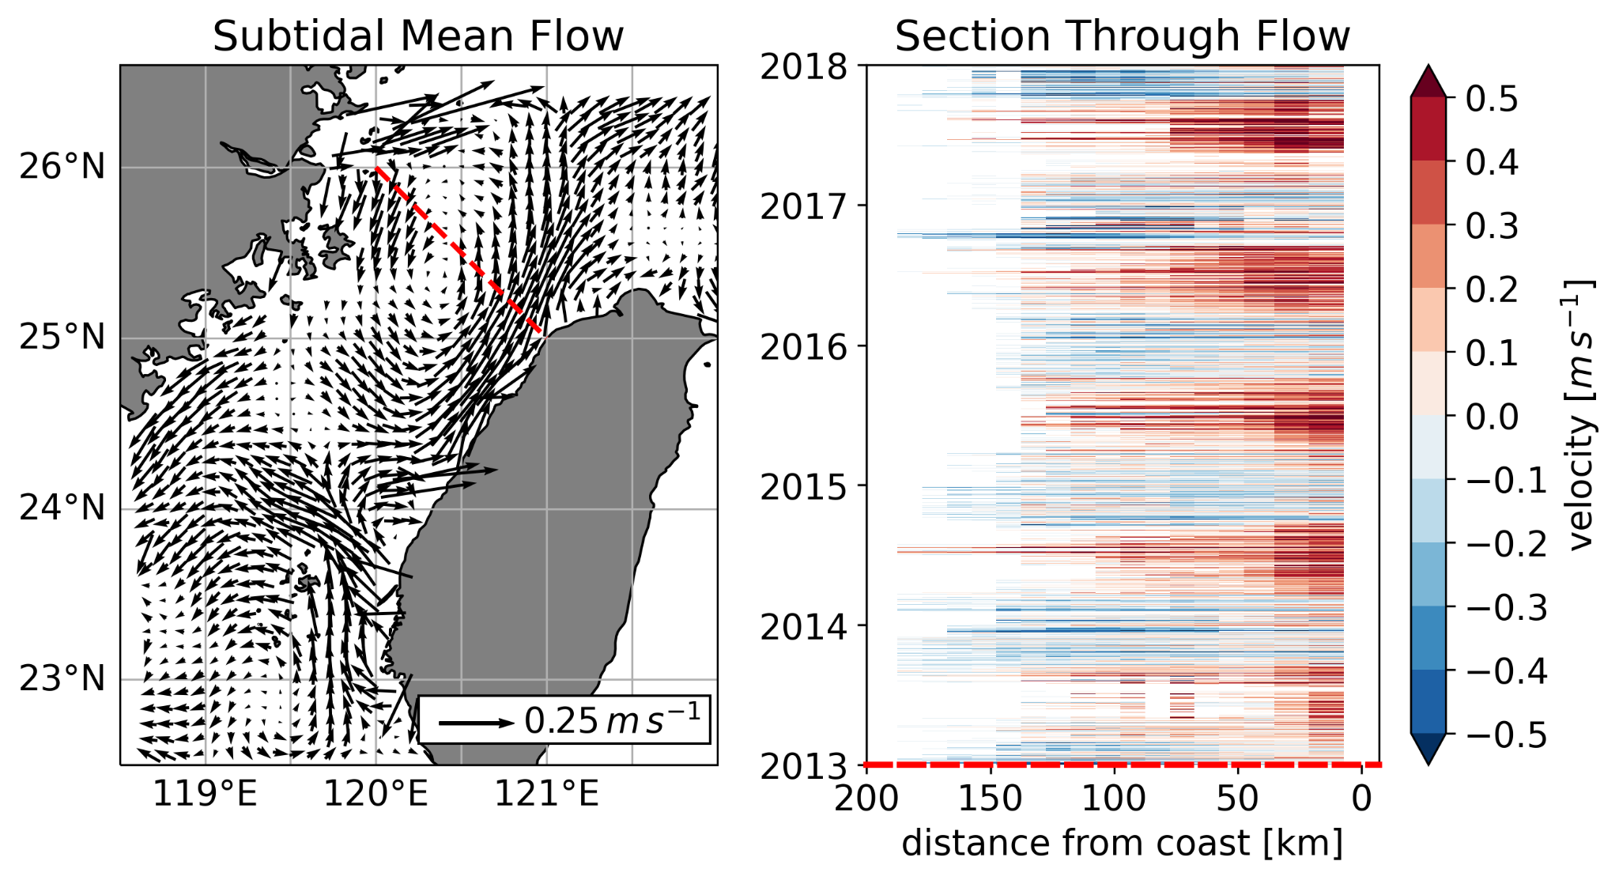
Mean Filtered Flow in Taiwan Strait

Slide 12
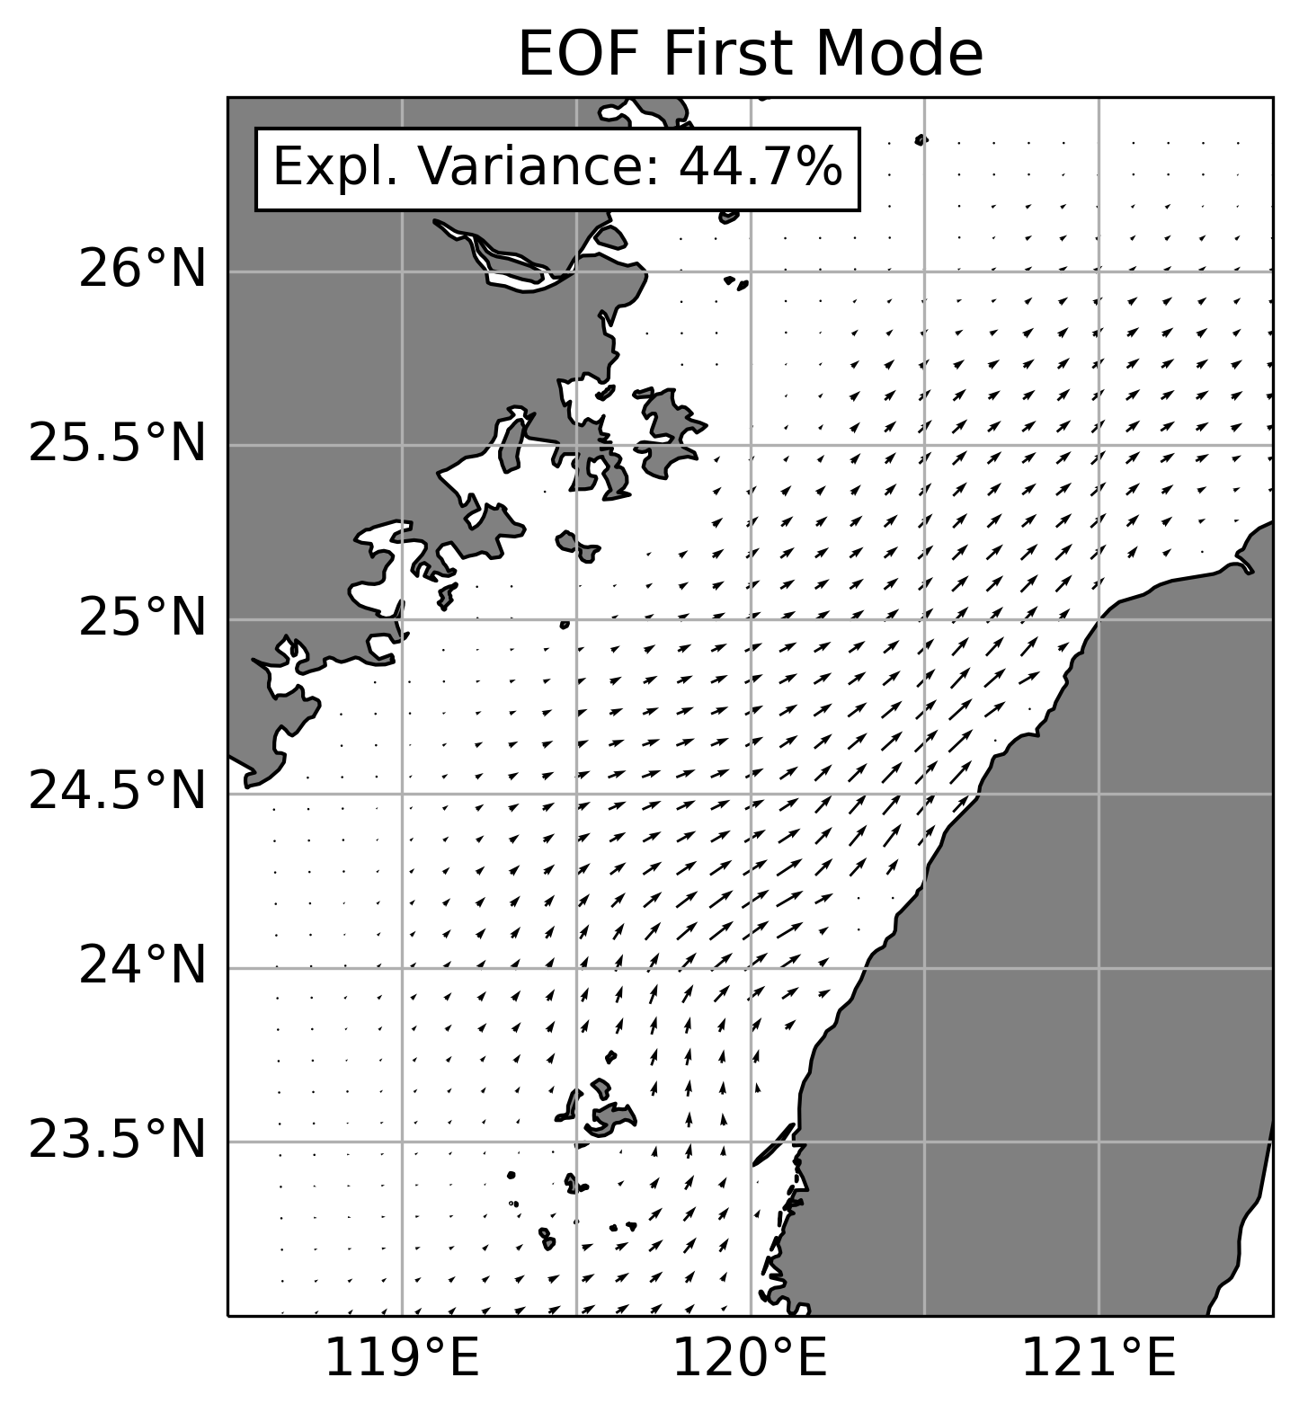
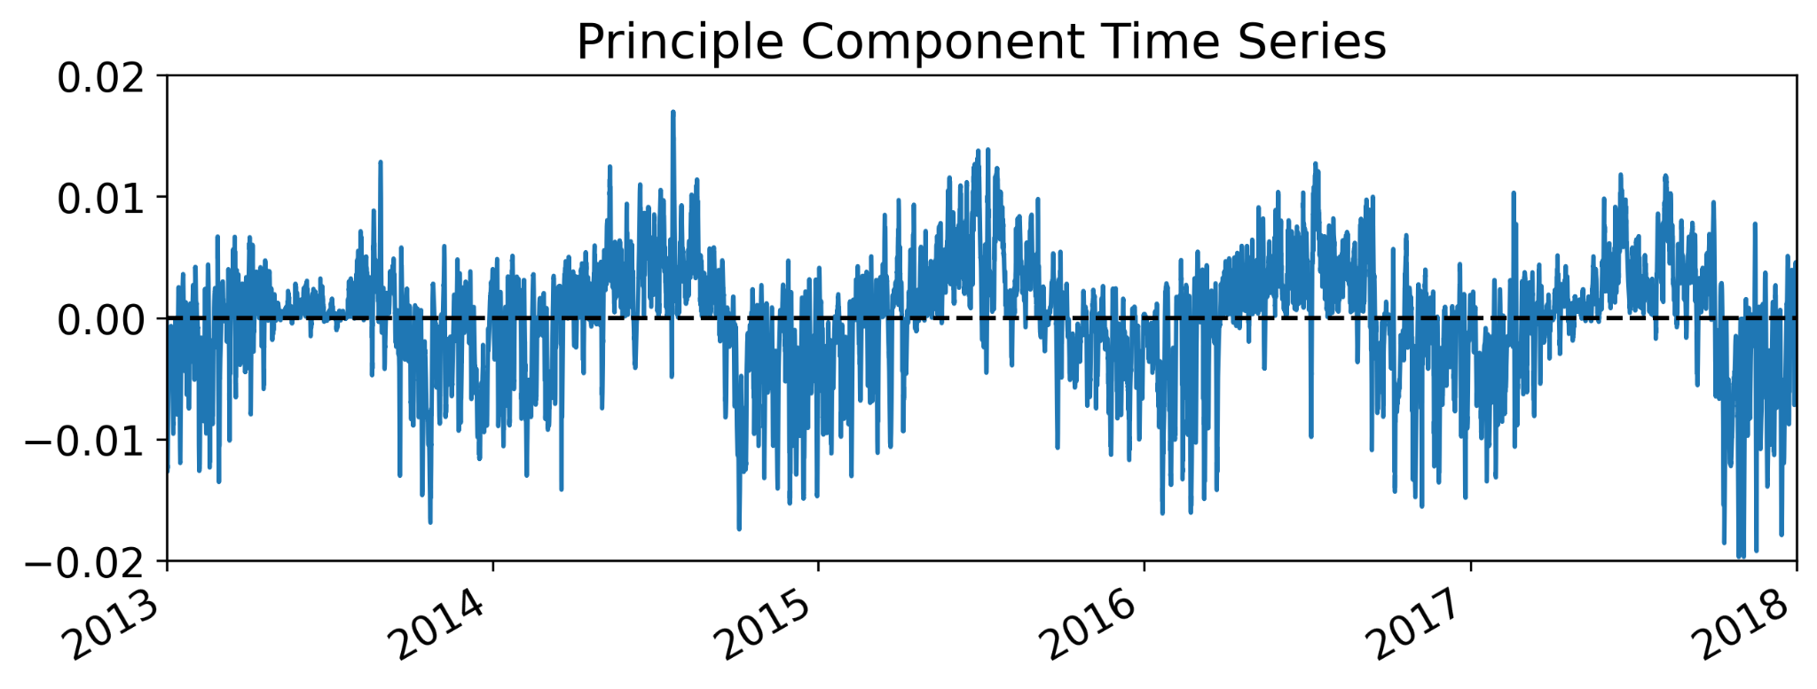
EOF Analysis
North-South pattern along the coast
Seasonal variation

Slide 13
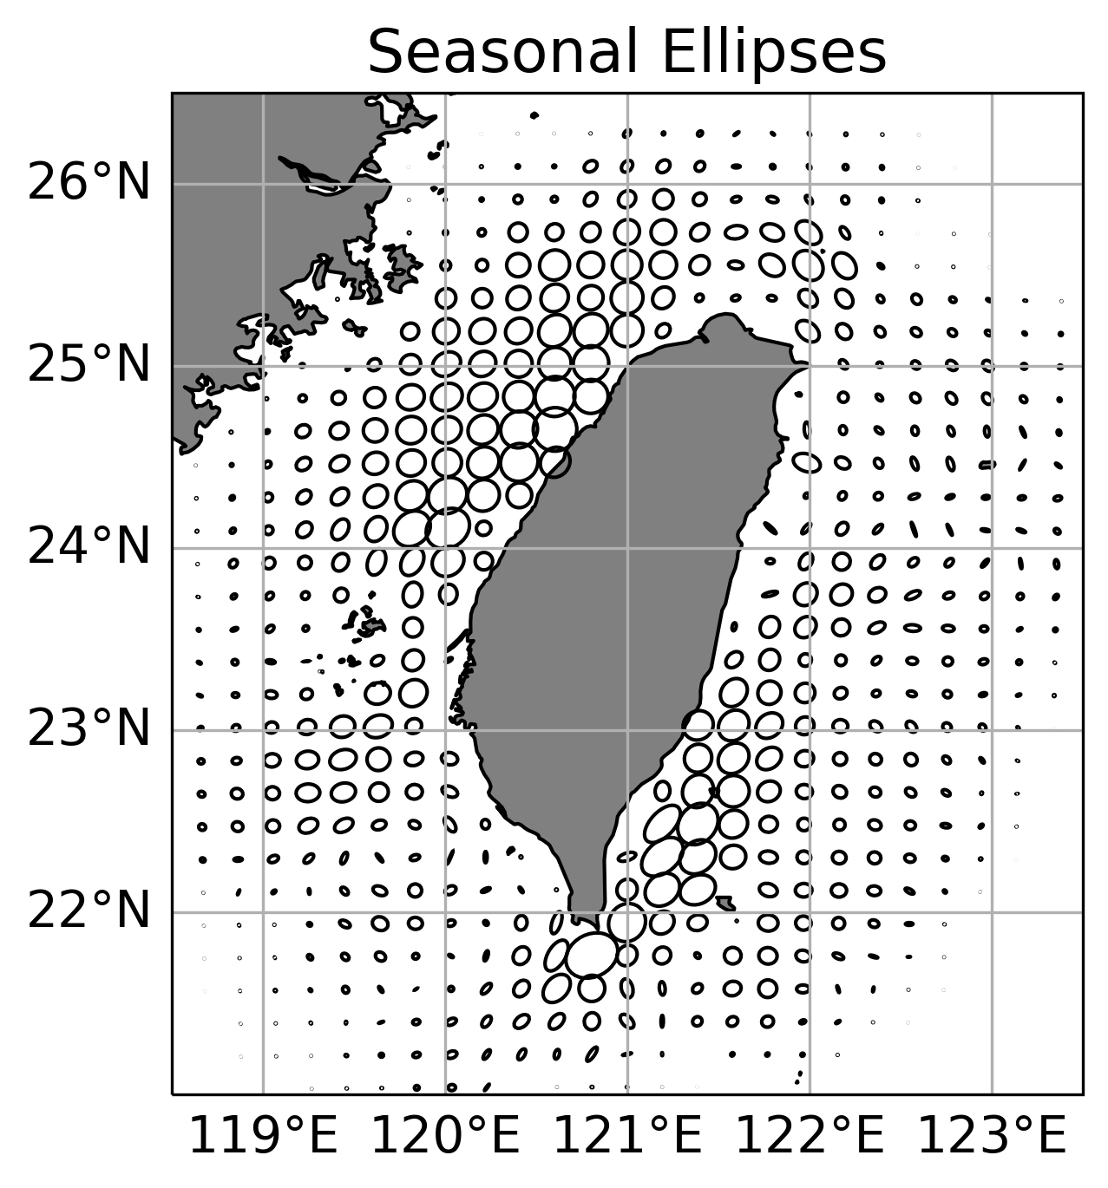
Seasonal Ellipses
Underlines enhancement near the coast in Northwest
Strong in Southeast as well
Kuroshio branch current?

Slide 14
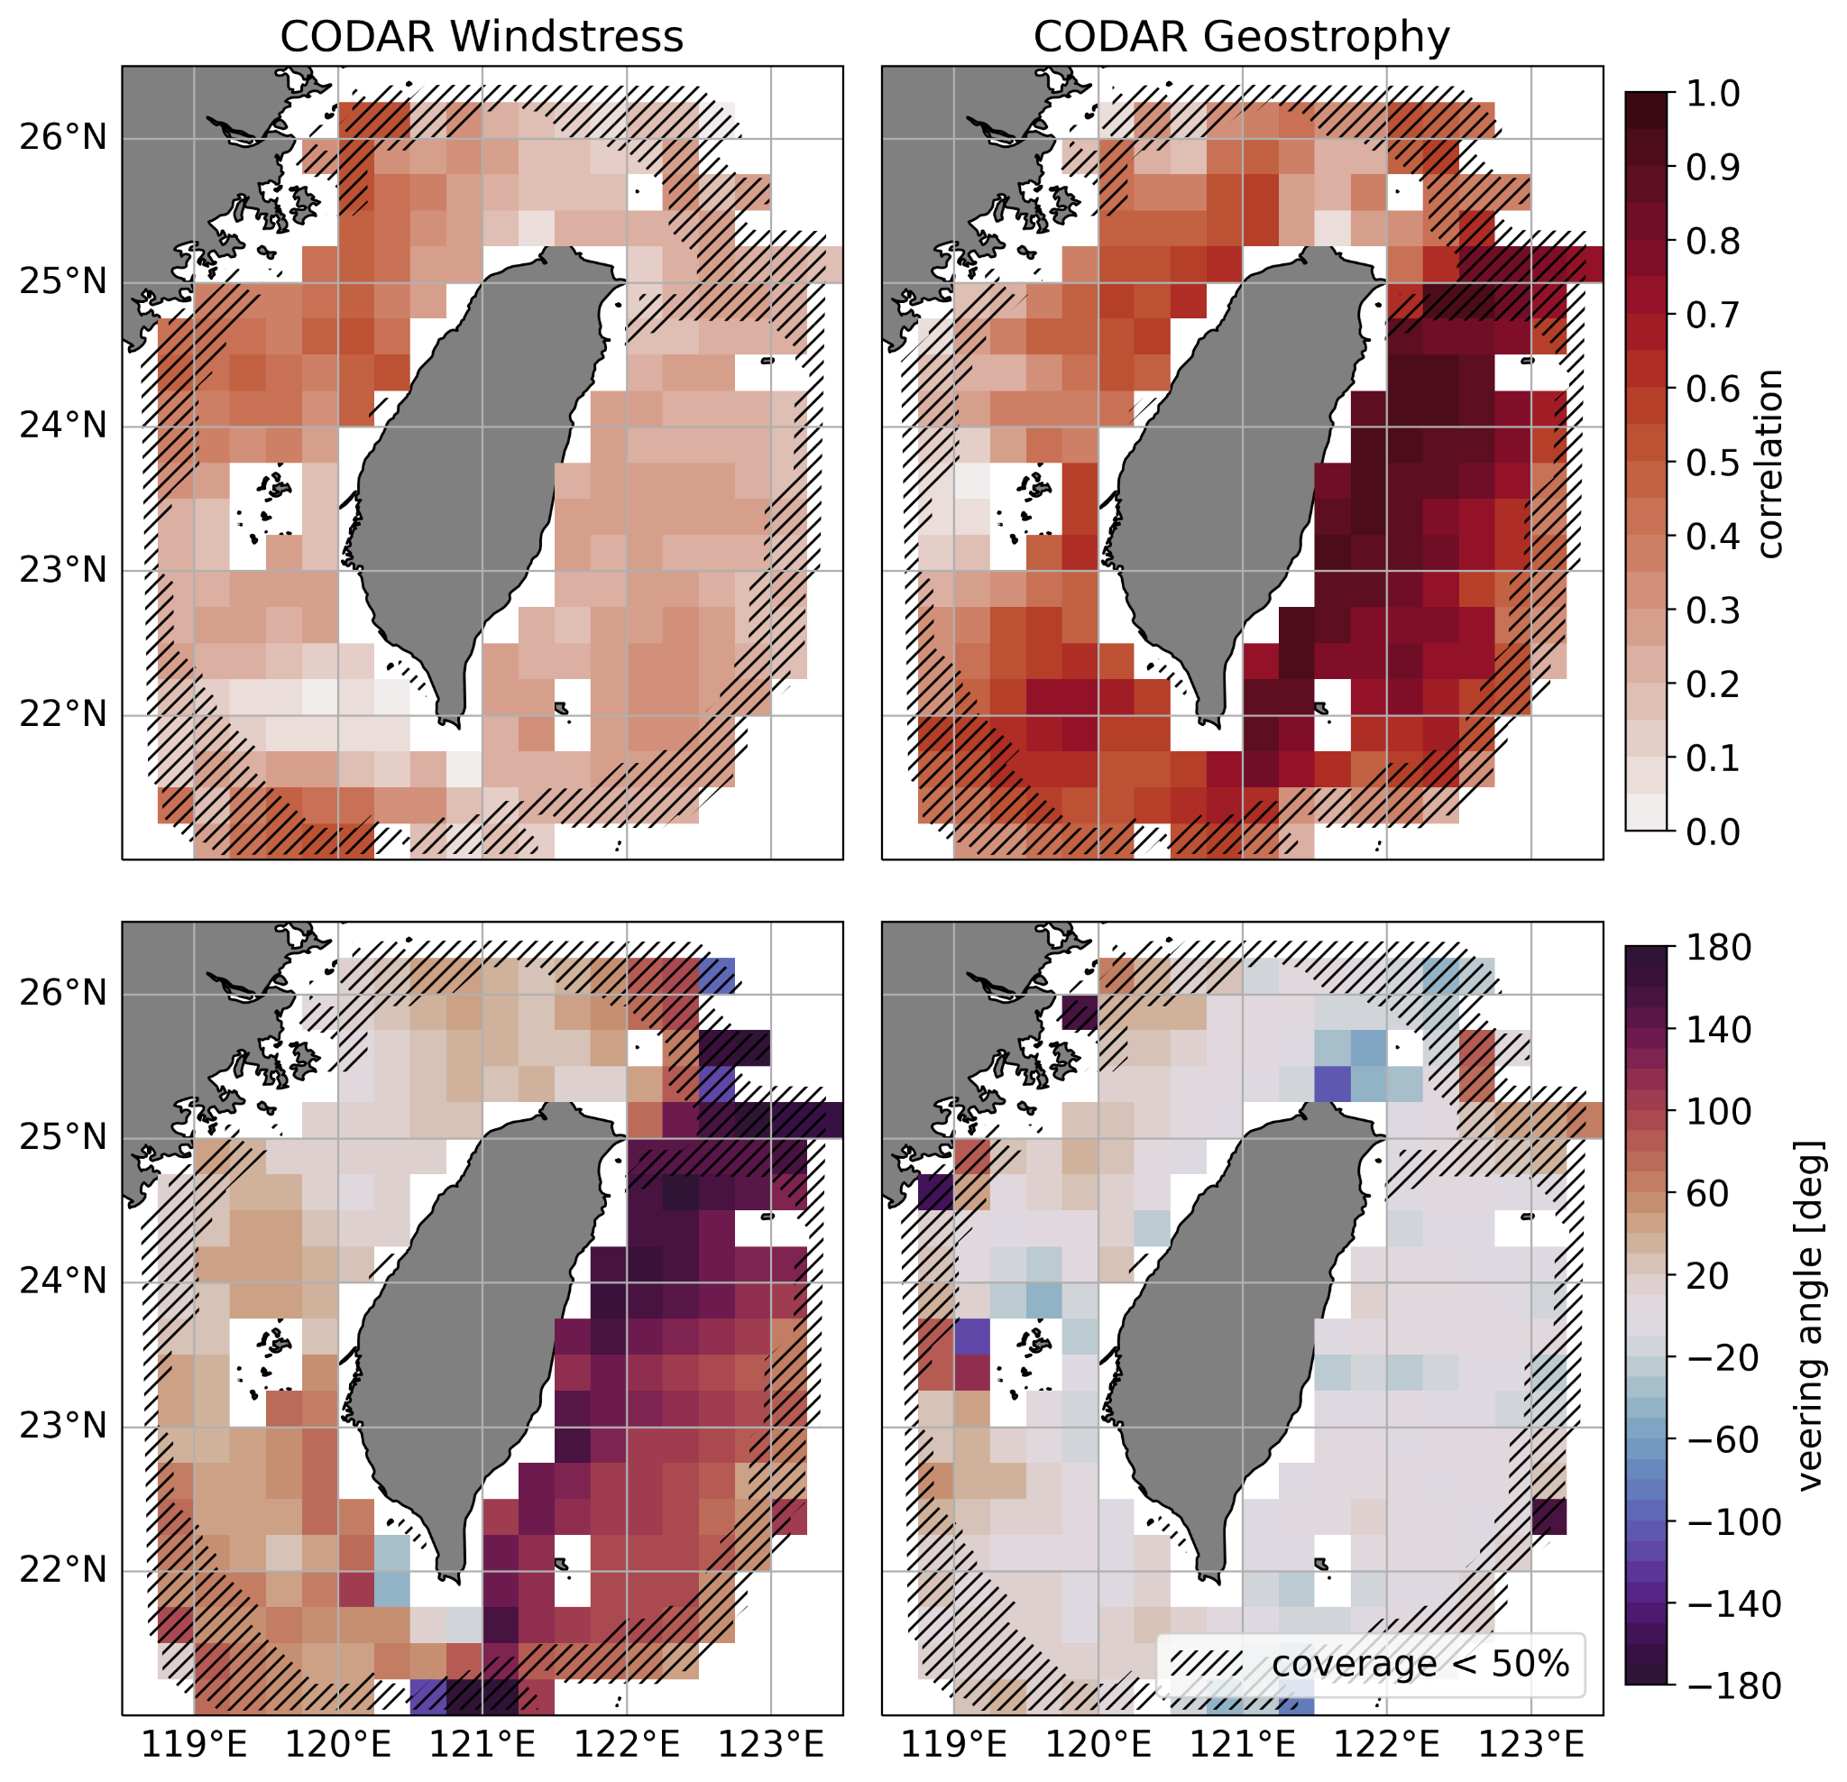
Vector Cross Correlations
Correlation between two 2D velocity vectors
Mean angle between both vectors
Windstress more important in Taiwan Strait
Angle in range of Ekman Dynamics
Max correlation at 2-5 hours in Taiwan Strait
Geostrophy dominates the east
Direction is quite the same

Slide 15
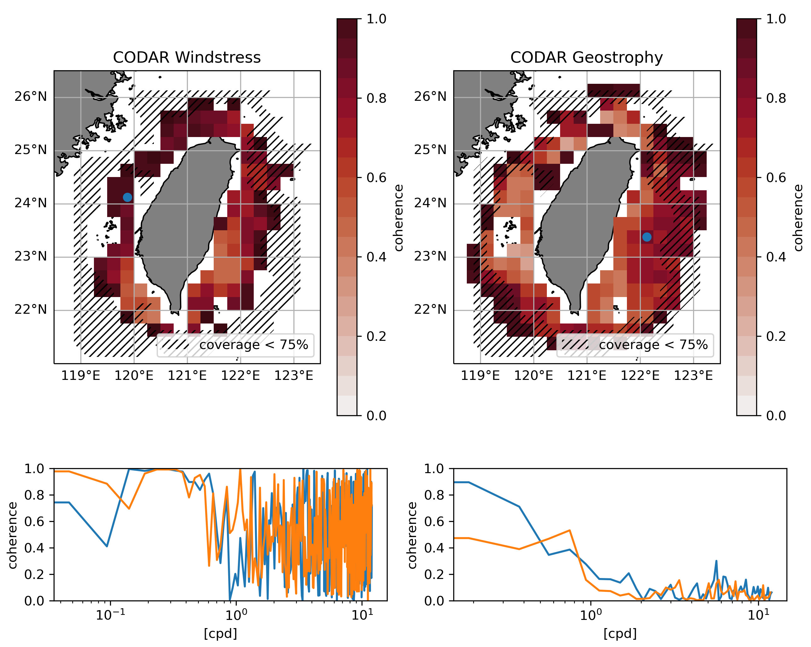
Coherence
Not easy to compute with missing values
Strong coherence between windstress and CODAR
High frequencies very messy
Relatively strong coherence between geostrophy and CODAR in the east
Secondary peak at 30 day period
Maybe related to mesoscale dynamic

Slide 16
Summary
Great dataset to study ocean dynamics around Taiwan
Tides are very prominent
Seasonal fluctuation in Taiwan Strait
Flow is largely related to satellite-derived geostrophic flow
Wind acts on seasonal timescales to influence the surface signal
Next steps?
Apply an eddy tracking algorithm to possibly investigate their interaction with the Kuroshio
Particle tracking for flow pathways
Code and figures at github.com/hgrosselindemann/TORI_Codar_Analysis
Thank you for your attention!

Slide 17
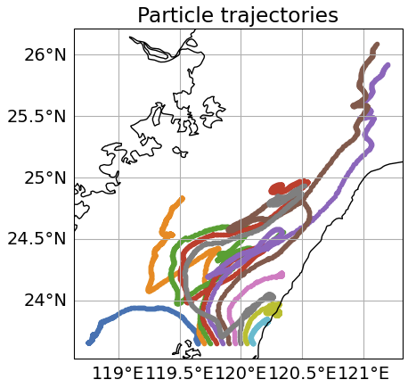
Particle Tracking
Applied particle Tracking on filtered velocities
Not sure if it is useful
Maybe release them on each day and end up with temporal particle density maps

